Slide 1
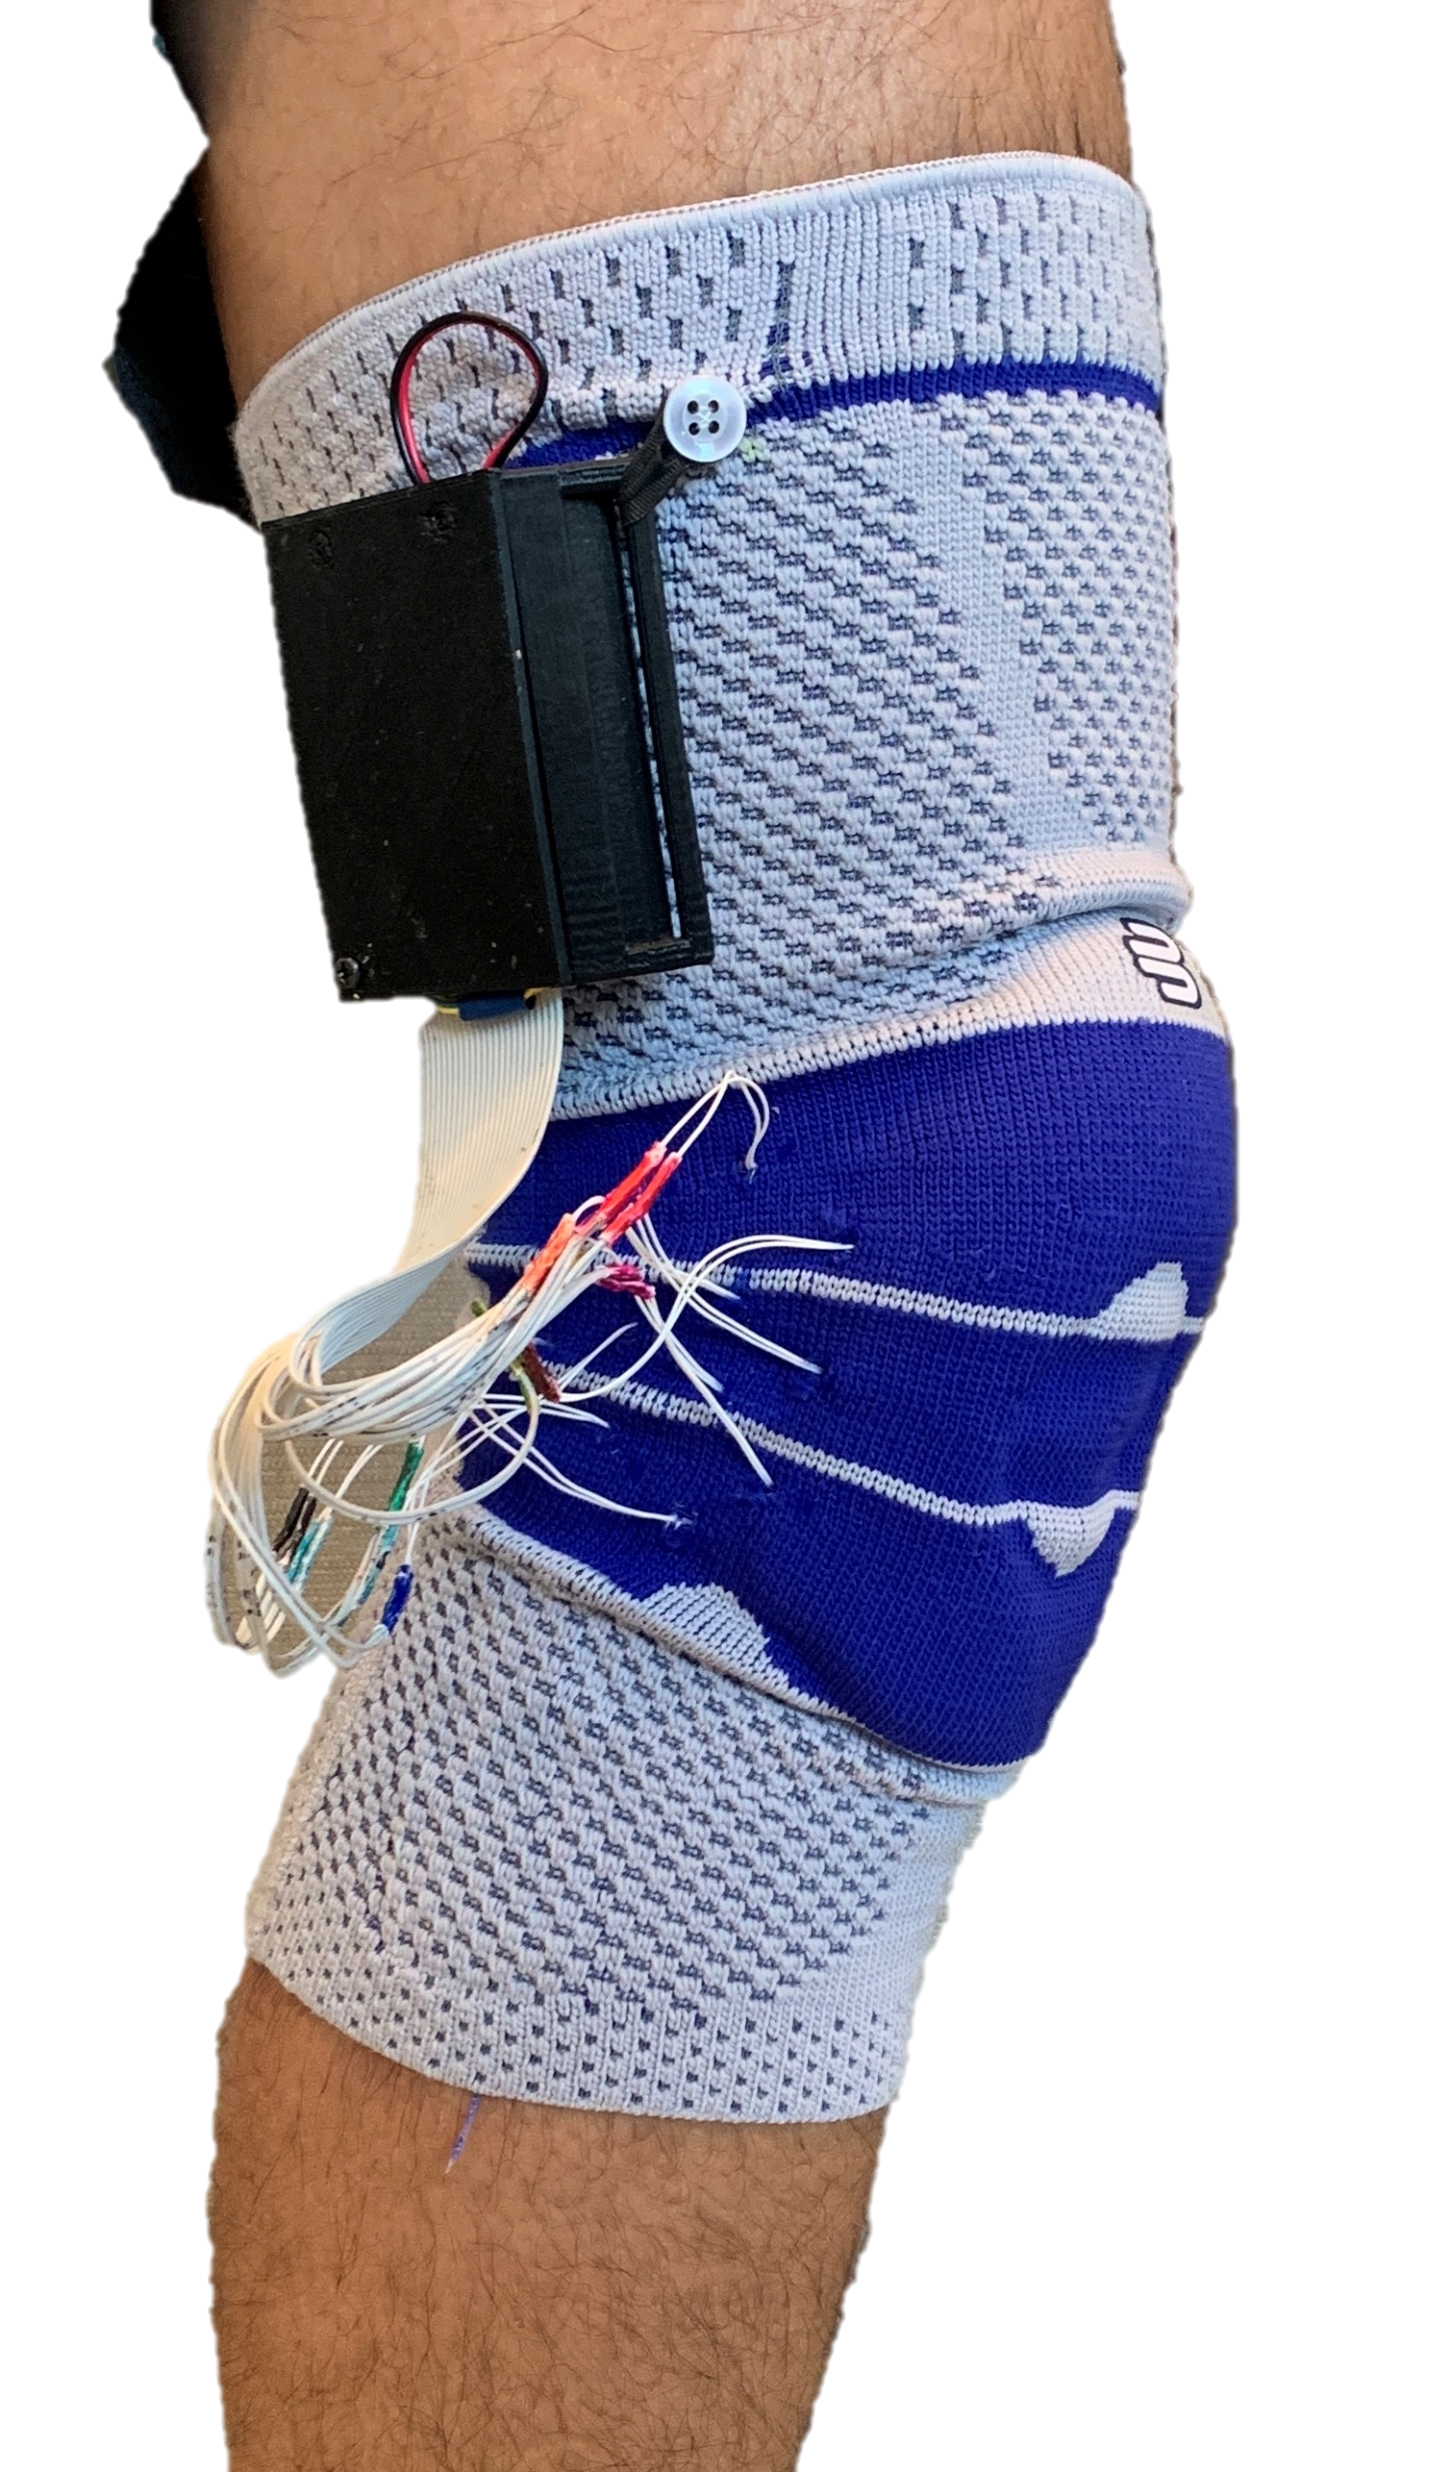
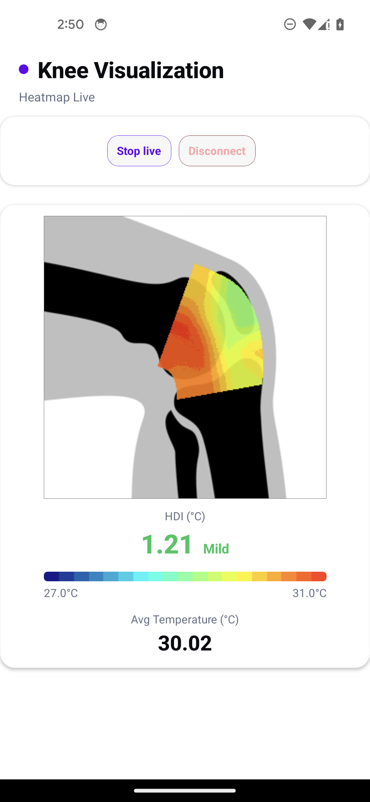
Embedded Electronics Module
Mobile App: Real-Time Heatmap + HDI
12-Thermistors Array
Thermistors Array
BLE Data Stream
HDI Reconstruction on App

